Slide 1
TOURISM OUTLOOK
May 24, 2021
City COVID-19 Recovery Emergency Committee

Slide 2
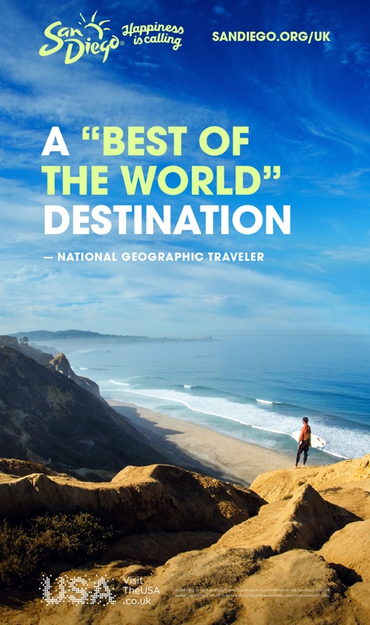

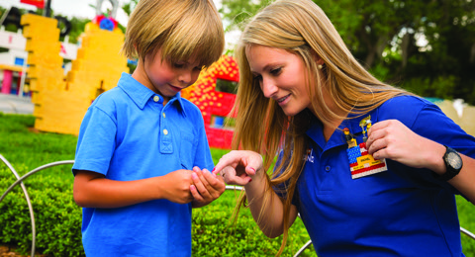
San Diego Tourism Authority
Driving Economic Benefit
NON-PROFIT 501(c)6
MISSION: To drive visitor demand to economically benefit the San Diego region
VISION: Leading San Diego to be the most desirable destination
FUNDING: 90% funded by Tourism Marketing District through annual application process
FY 2019 PROGRAM OF WORK: $52M invested in selling and marketing San Diego in 8 countries
TODAY: SDTA Budget down 52% (staff reduced 34% and focus is now on U.S. market only)
Notes:
A big part of what makes a difference for San Diego is that we have a substantial budget to promote our destination. This year the Tourism Authority’s budget is at $52 million. While no where near the budget of Las Vegas or Los Angeles, our budget does enable us to promote on a global scale and generate billions of impressions to attract travelers to our region.

Slide 3
San Diego’s Tourism Economy
20 Years of Economic Gains LOST Due to COVID

Slide 4
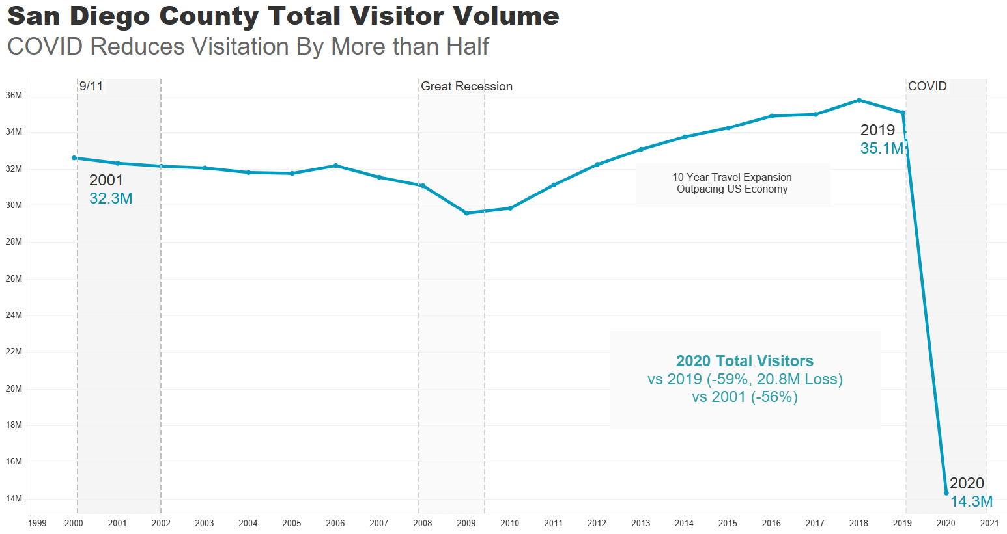

Slide 5
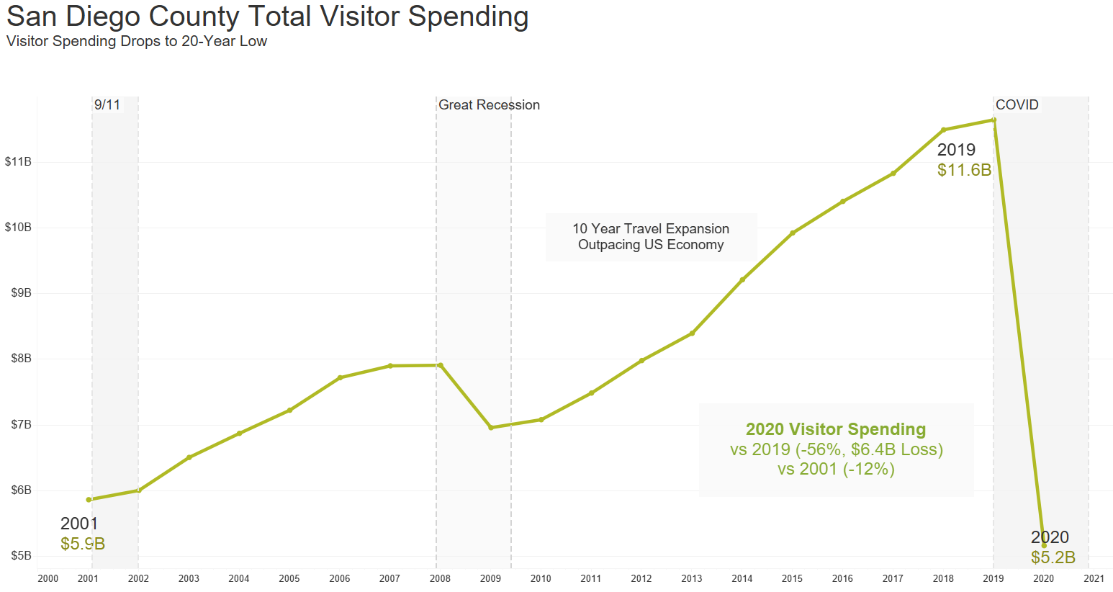

Slide 6
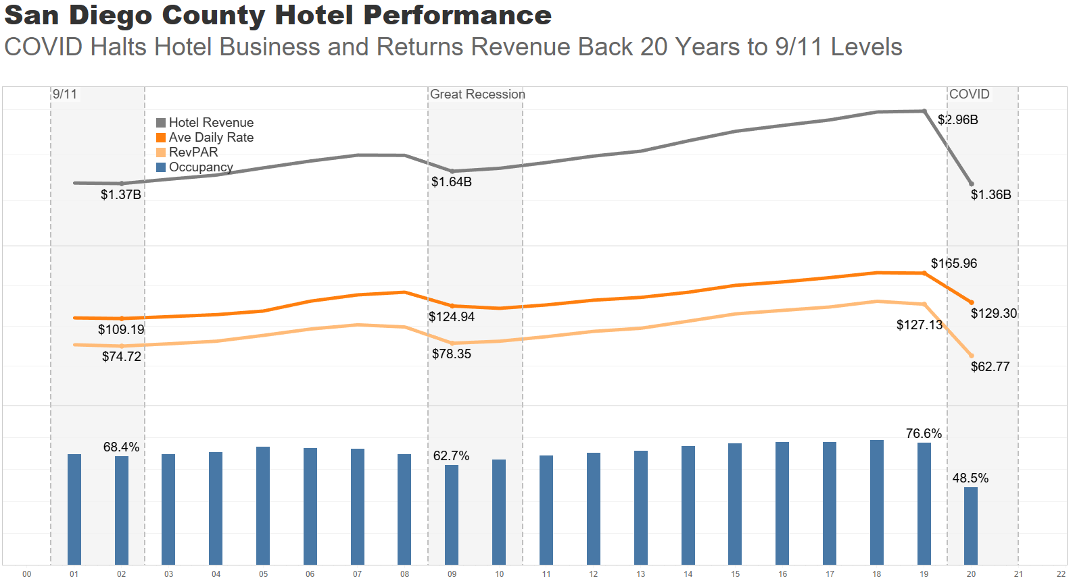

Slide 7
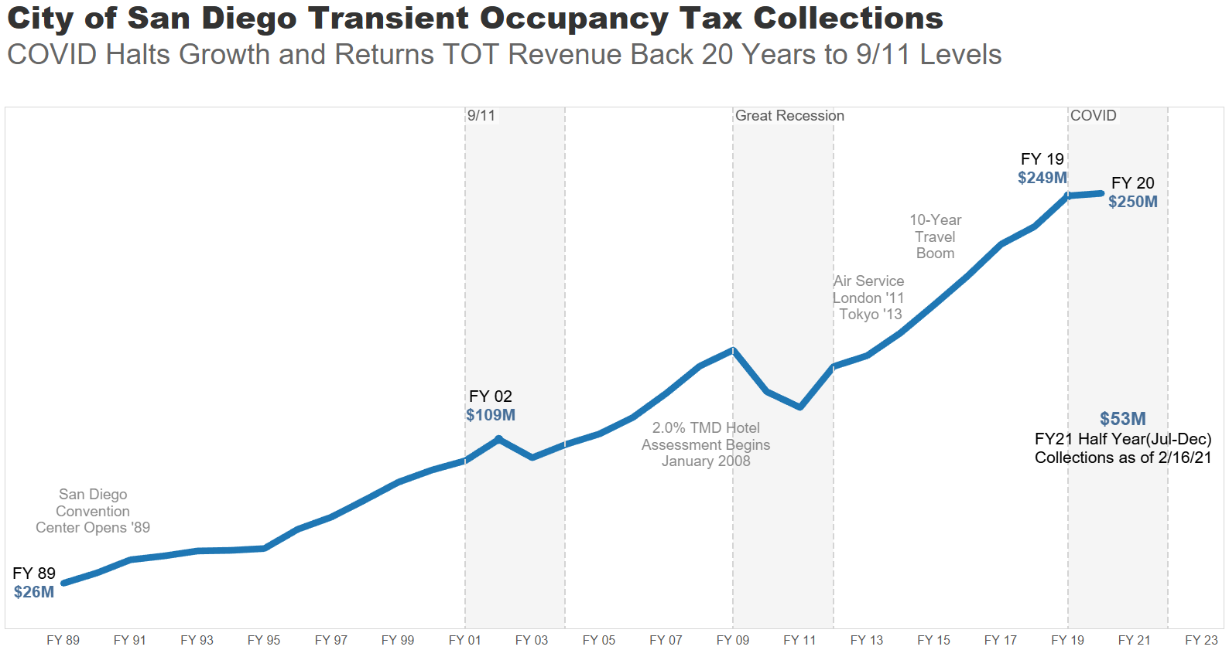

Slide 8
REBUILDING SAN DIEGO’S
TOURISM ECONOMY

Slide 9
SAN DIEGO’S VISITOR INDUSTRY
Hotel Visitors generate 68% of all visitor spending
Leisure travelers provide good visitor volume, business travelers provide a foundation to build pricing power:
  70% of Hotel Visitors are Leisure/Transient
  30% are Hotel Meetings (24%) and SDCC Conventions (6%)
Of all visitors in 2019, 17% were International with Mexico Day Visitors the largest segment (Mexico Day down 88% in 2021 impacting San Diego restaurants, retailers and attractions)
San Diego competes with Southern California cities, Hawaii, Las Vegas and Mexico in addition to popular convention cities like San Francisco, Phoenix, New Orleans and Orlando
California has been closed longer than other states, and has lost market share to Florida, Colorado, Texas and the Carolinas

Slide 10
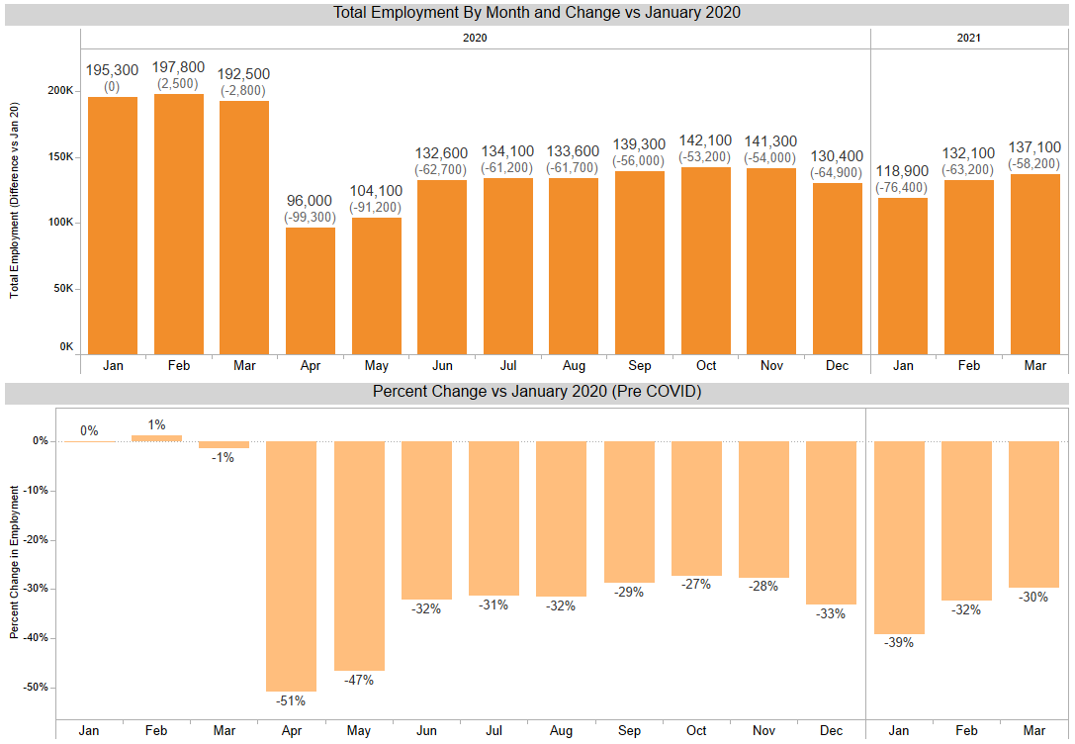
Employment Ticks Up
As the state reemerges from the latest stay-at-home lockdown, hospitality & leisure employment in San Diego is slowly rising.
However, through March, more than 58,000 jobs are still missing from the industry, or 30% of the pre-COVID labor force.

Slide 11
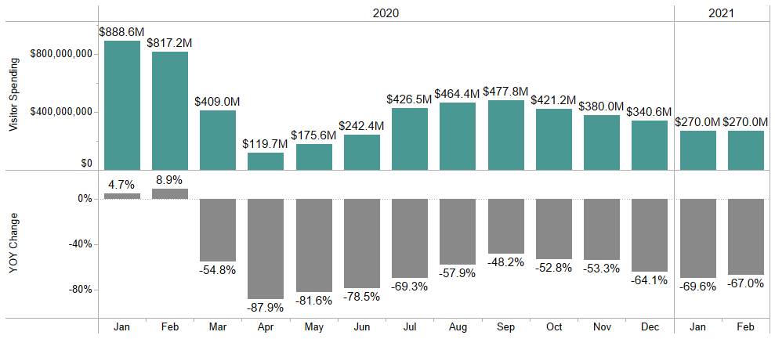
Visitor Spending Remains Low
In 2020, San Diego lost $6.5 billion in visitor spending. Through February 2021, the county is $1.2 billion below 2020 levels.

Slide 12
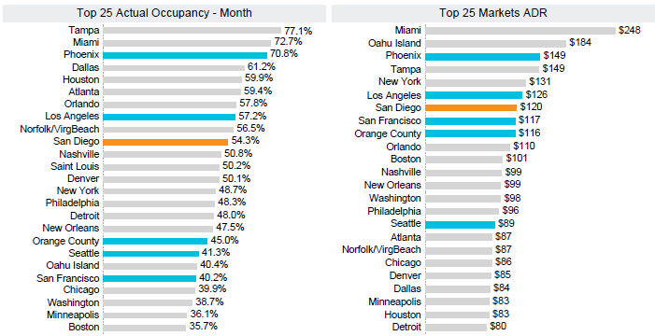
Hotel Performance March 2021
San Diego County sold more than 1.06 million room nights in March, more than any other month since COVID began.
#10
54.3%
#7
$120

Slide 13
SAN DIEGO TRAVEL FORECAST ASSUMPTIONS
Updated March 2021
 | 2021Q1 |  | 2021Q2 | 2021Q3 | 2021Q4 | 2022Q1
Virus | Virus surge eases as vaccination programs accelerate rapidly. Regional stay-at-home order lifted in January. |  | Vaccination programs and public health measures result in low infection rates by the end of the quarter. | Infection rates remain low, certain restrictions on crowds/density continue. | US is broadly “safe from Covid-19”, with low infection levels. Conditions are similar to a very bad flu season, Some outbreaks still occur in regions of the country.
International | International inbound travel to US remains substantially reduced |  |  | Easing restrictions on international inbound travel to US |  | International travel gradually improves
Business travel | Corporate travel restrictions by major employers remain in place |  |  | Corporate travel restrictions gradually ease nationally |  | Corporate travel improves
Leisure travel | Leisure travel improves as state-at-home order is lifted. | By Q2, leisure travel improves to levels ahead of 2019 |  |  |  | Leisure improves
Group travel | Virtually no San Diego group demand. Very low level of emergency and essential business group demand. |  |  | San Diego group demand begins to gradually resume with restrictions. Assume meeting venues are permitted by the state to operate at 25% capacity during Q3 and Q4. Assume no citywide events until September and then only a few citywide events in Q4. |  | Restrictions are lifted with enough lead time that group demand improves solidly.

Slide 14
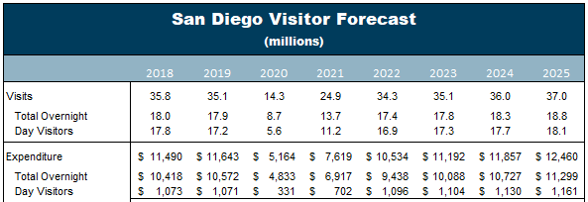
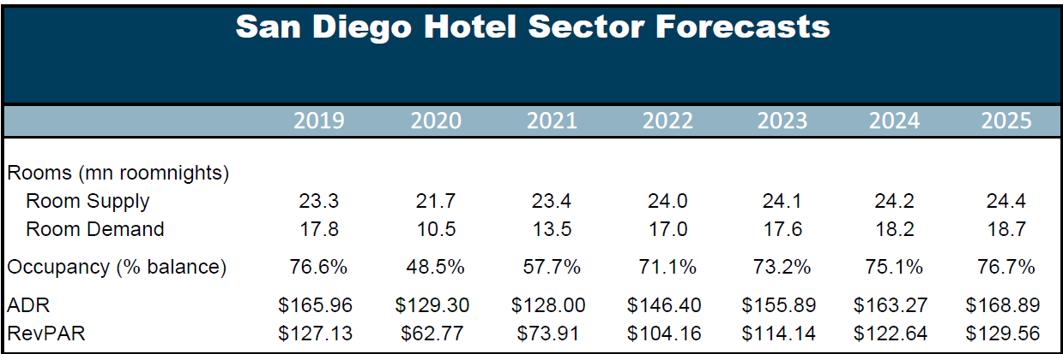
San Diego County Travel Forecast
April 2021 update
The Recovery (back to 2019 levels)
Expected to take 4 to 5 years depending on metric and visitor segment
Key to recovery is pricing power
Visitation and Spending
Overnight Visitors – 2024
Day Visitors – 2025
Visitor Spending - 2024
Hotel Sector
Room Supply - 2021
Room Demand - 2024
ADR 2025
RevPAR 2025
Source: Tourism Economics

Slide 15




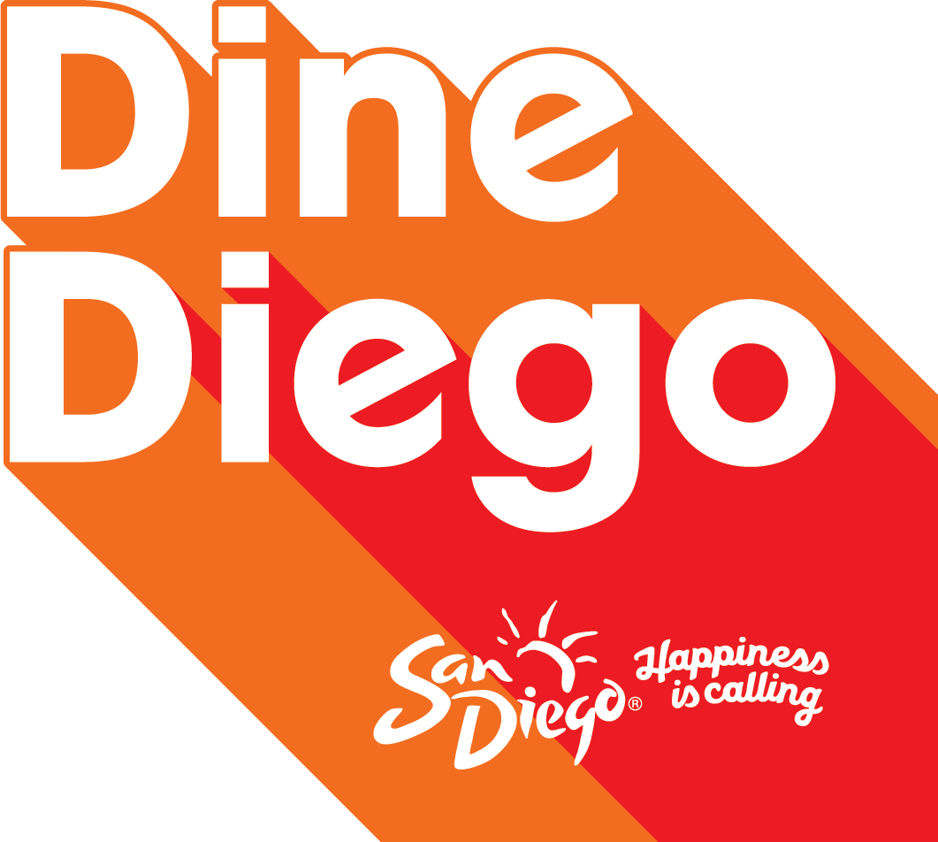
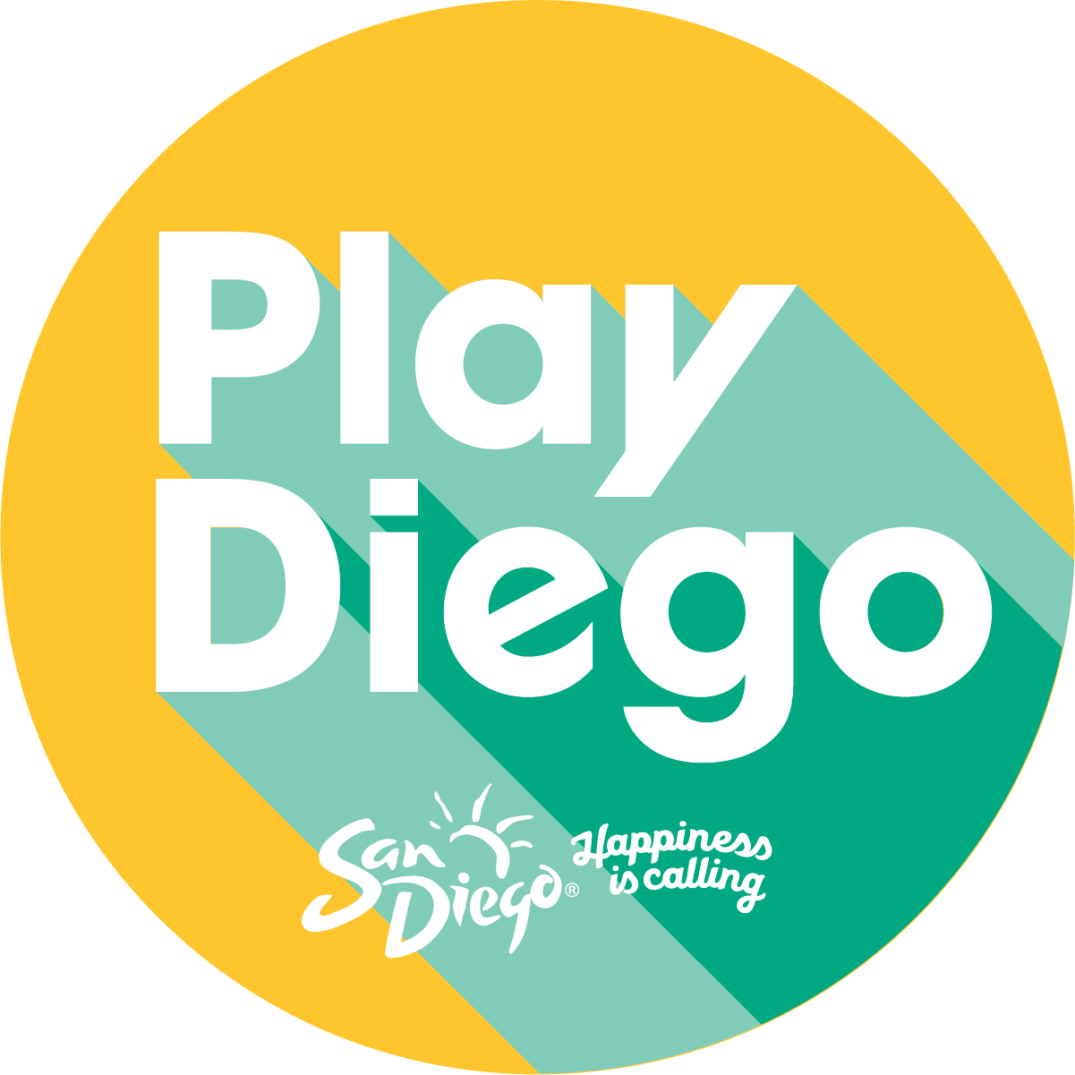
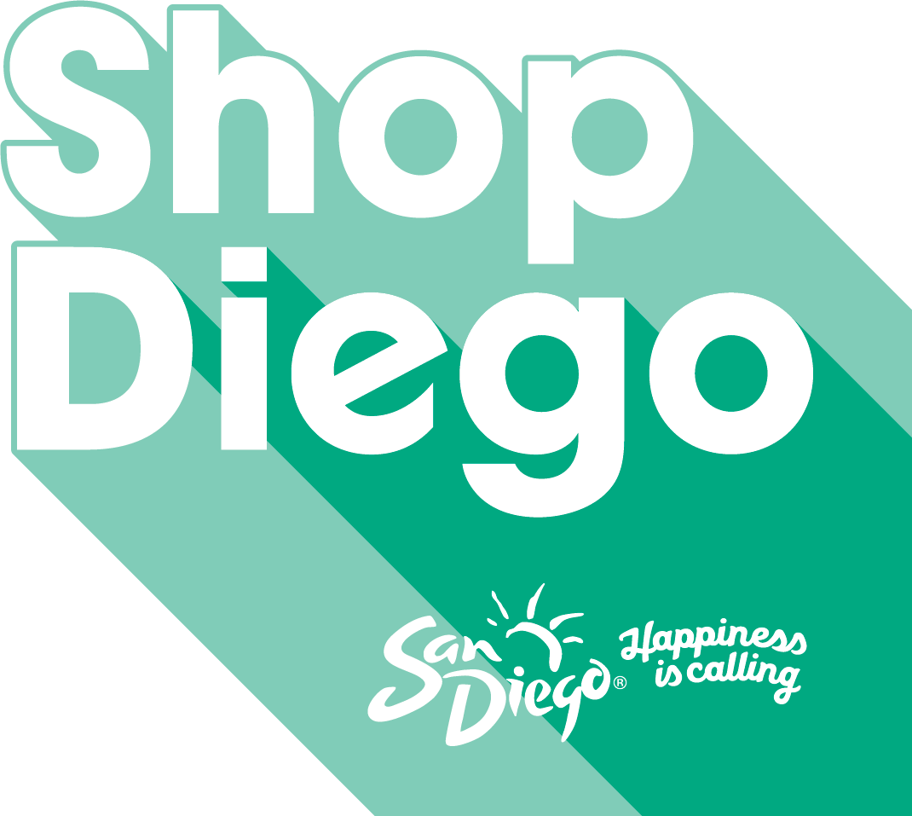
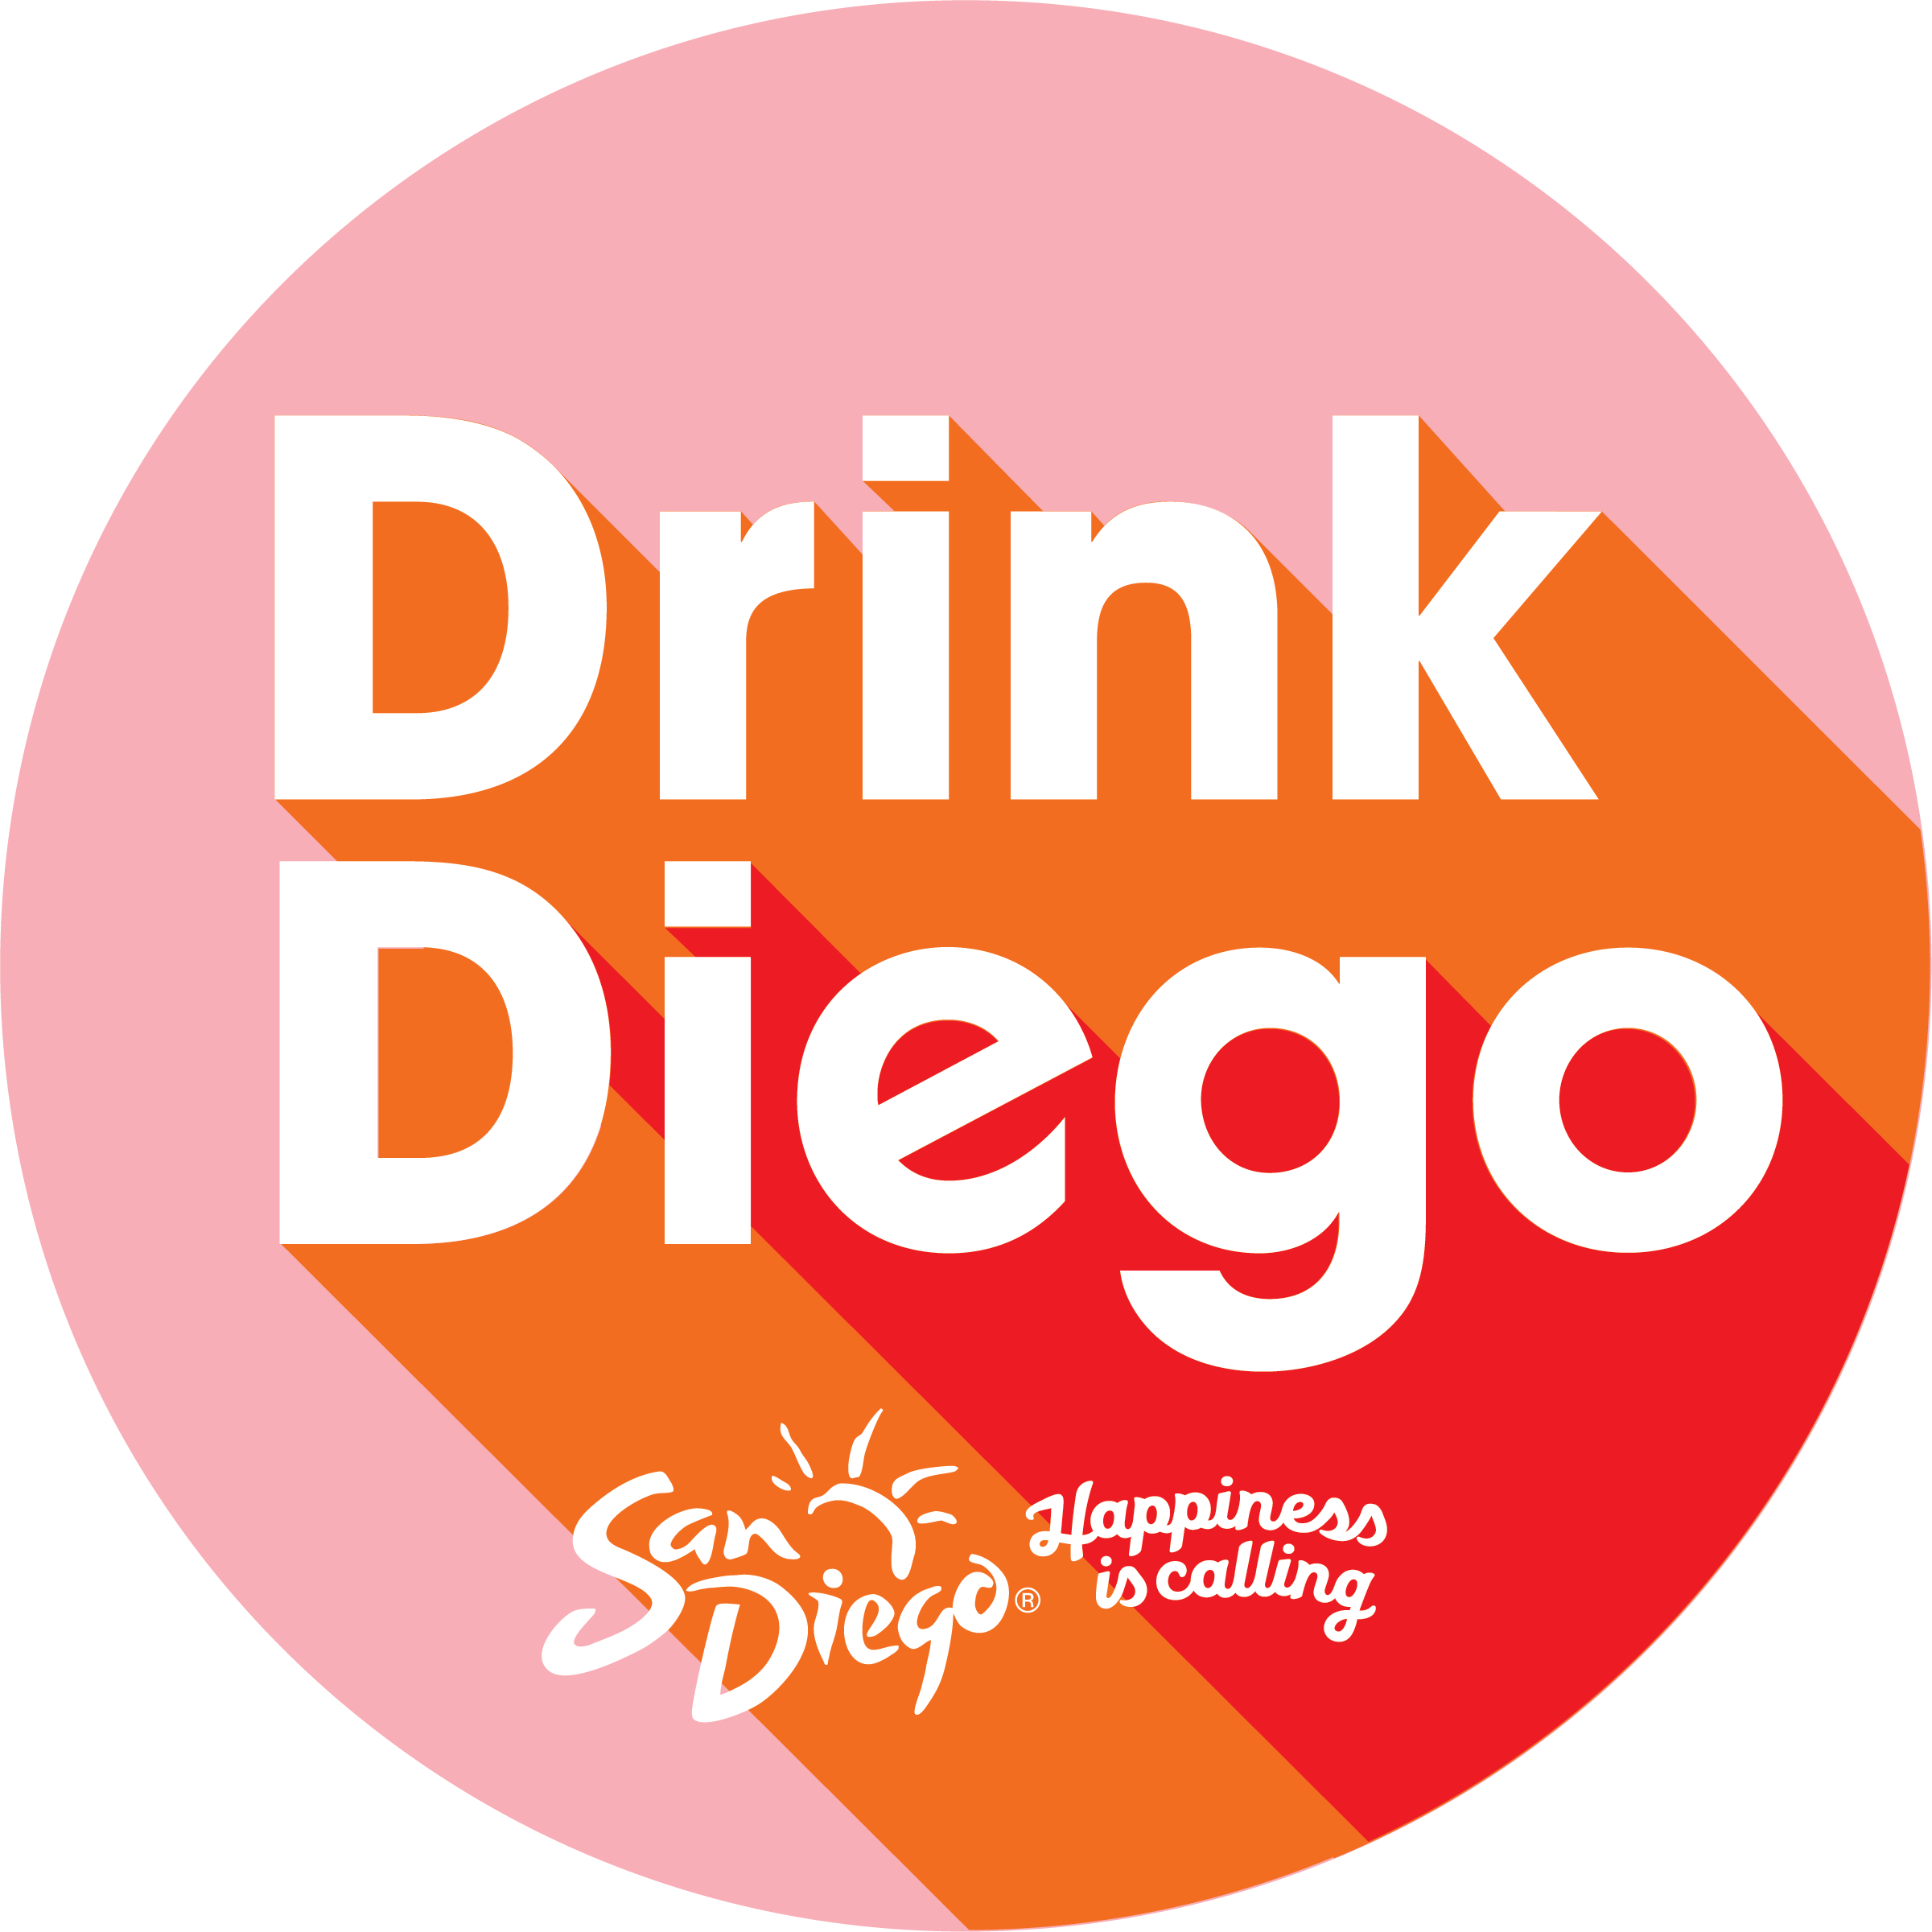
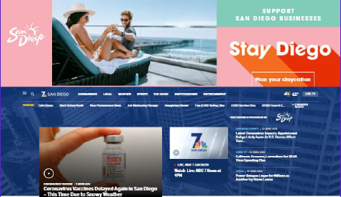

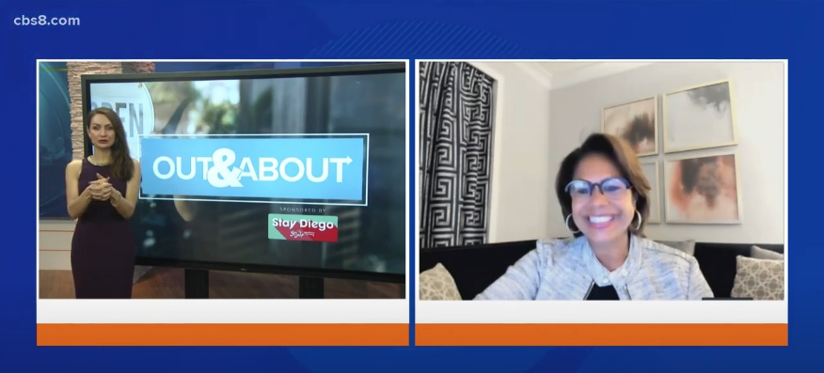
Local Staycation Marketing Initiative
1
Targeted to locals, the February – March “Stay Diego” campaign relaunched for a Spring flight and encouraged San Diegans to come together in support of our tourism community and book a staycation at a local hotel and dine, shop, and play local, which, in turn, will help stimulate our economy.
More than 13.9 million impressions were delivered locally through custom sponsored content, in-news content mentions, network taggable creative, premium homepage takeover placements and digital display advertising.

Slide 16
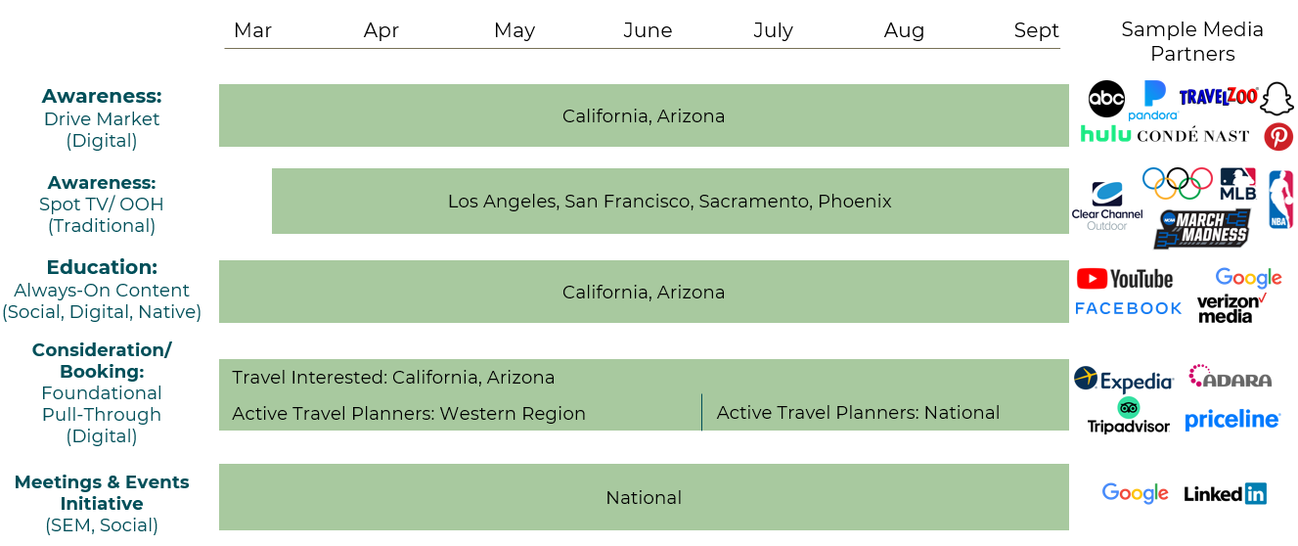
San Diego Tourism Recovery
Drive Markets Advertising
2
$8 Million Media (July – December 2021)

Slide 17
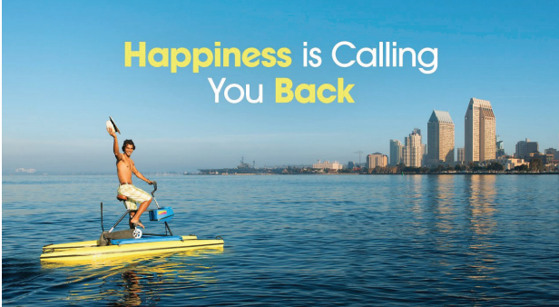

San Diego is Open for Meetings
3
Supporting Direct Sales for Conventions and Hotel Meetings with NEW “Happiness Is” group meetings campaign to announce San Diego is open for meetings and conventions.
San Diego is defined by a Sunny Outlook:
a place that inspires positivity and optimism.
Leisure
Groups/Meetings
San Diego’s positivity and optimism is fueled by our good vibes and wide-open spaces.
San Diego’s positivity and optimism inspires endless creativity, innovation and opportunity.
Brand Extension

Slide 18
On the Road to Recovery
As with post 9/11 and the Great Recession, San Diego is well positioned to outperform competitive destinations in the short-term. Driving Leisure Travel is an imperative while rebuilding Meetings and Conventions.
Air travel and longer distance trips will gain traction. San Diego needs to be positioned to return and maintain National Advertising campaigns over the next 5 years.
International travel will return, and San Diego needs to be positioned to support direct air service.
Corporate travel to San Diego has been growing and should continue to provide a foundation for the destination as Government, Biotech and Navy-related sectors expand.
Development of new hotels and visitor infrastructure is concentrated in North County (Encinitas, Carlsbad and Oceanside) and South Bay (Gaylord Chula Vista opens 2023) creating more pressure on City of San Diego to maintain its share of visitors.

Slide 19
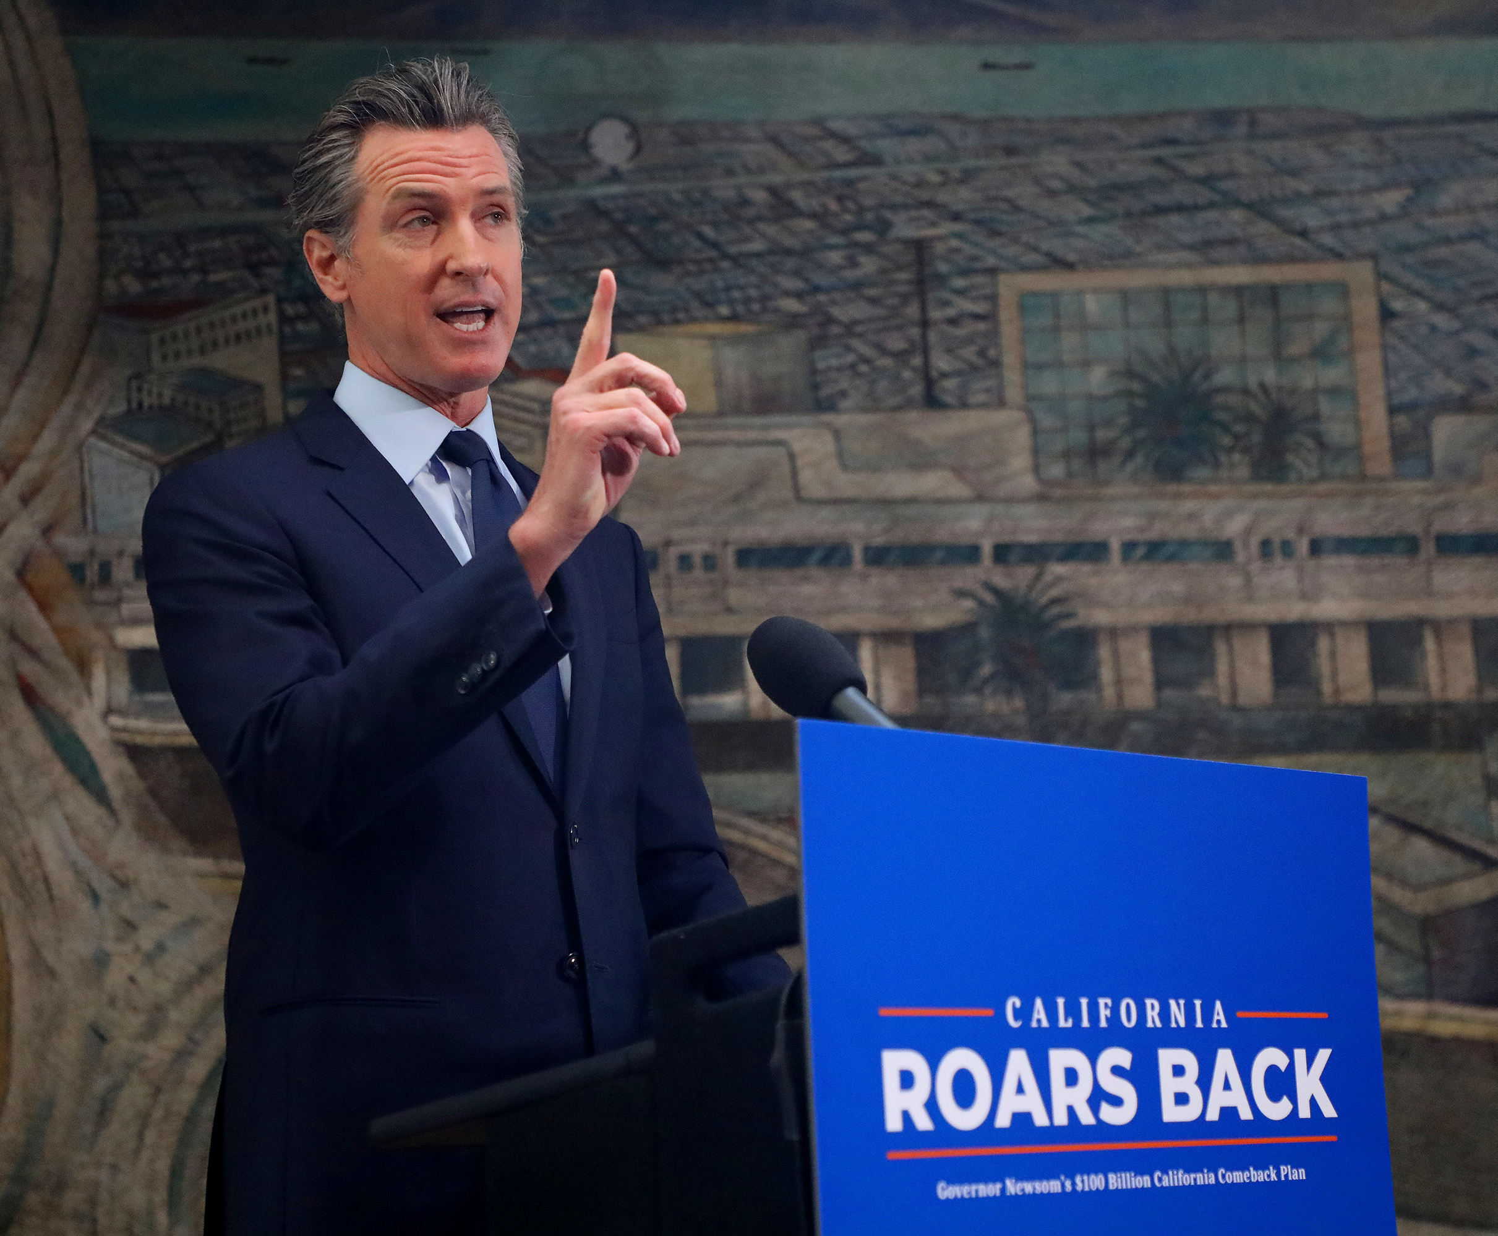
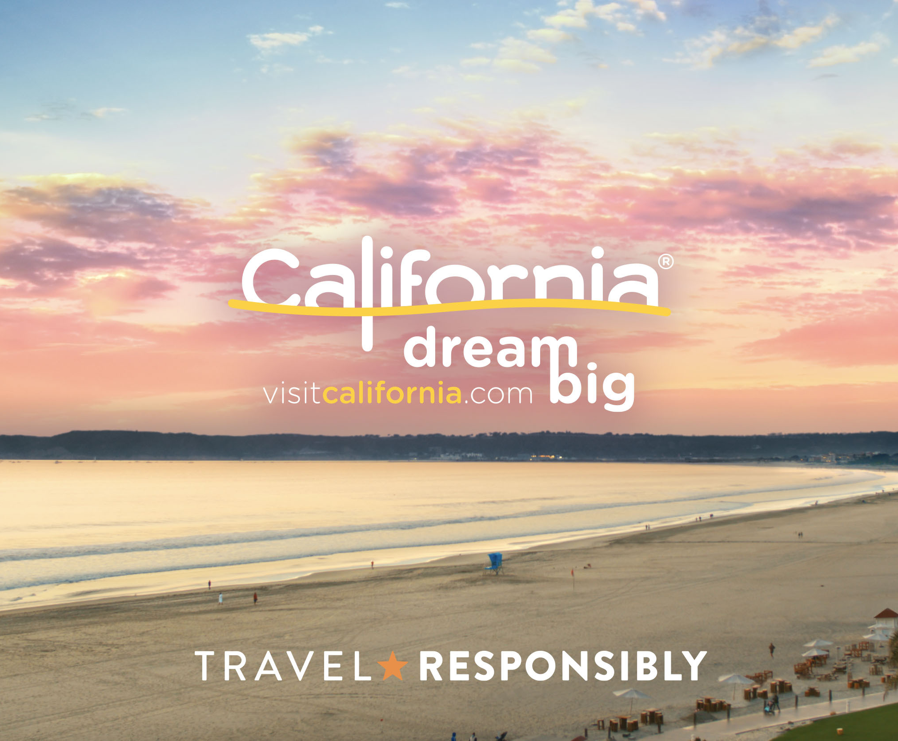
$95M Emergency Stimulus for Visit California
Governor has proposed $95M in emergency funding for Visit California to augment their assessment revenue income which dropped during the pandemic
California has lost market share to Florida, Texas, Colorado and the Carolinas
Visit California will now be able to continue advertising the state this summer and fall to help rebuild visitation

Slide 20
Supporting Recovery
  Recognition that we are looking at many years to return to 2019 levels of visitor spending, tax revenues and employment
  Concerns that we have as our sector begins its recovery – loss of business to other states, ability to hire, slow return of pricing power, uncertain status for small businesses, potential future shocks whether health or economic related
  Outlook on Meetings and Conventions – hybrid solutions during transition back to F2F, reduced attendance especially in international
  Appreciation for the role our City and County have played in helping our industry – loans, advocacy for guidelines, support for our businesses and workers, support for the SDTA as the City’s marketing partner in promoting the San Diego Brand
  Concerns about our Destination Experience including safety and cleanliness for residents, workers and visitors

Slide 21
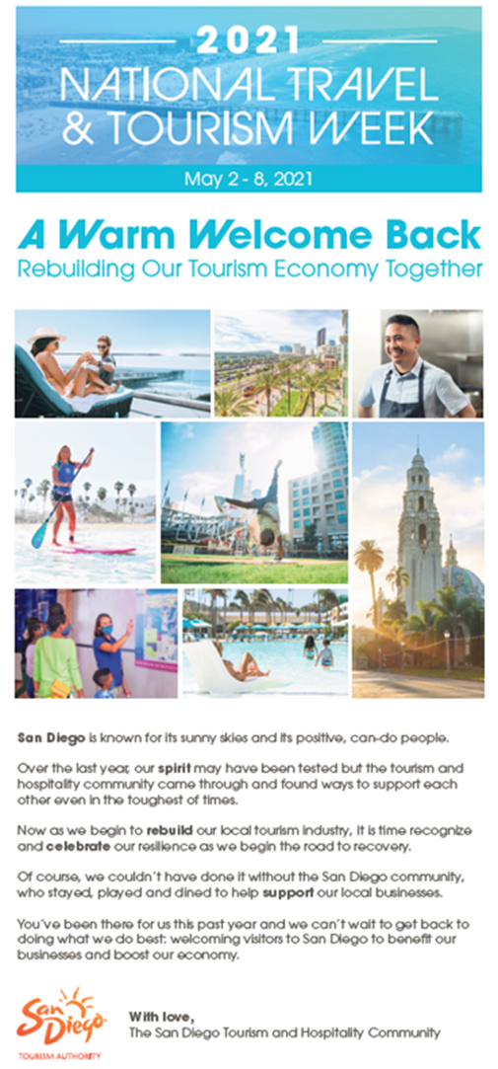
THANK YOU!
Kerri Kapich, COO, San Diego Tourism Authority
kvkapich@sandiego.org

